Slide 1
Secure data hiding in image using steganography
CAPSTONE PROJECT
Presented By:
Student Name : Rudrarajsinh Gohil
College Name & Department : Gyanmanjari Institute of Technology (Information Technology)

Slide 2
OUTLINE
Problem Statement
Technology used
Wow factor
End users
Result
Conclusion
Git-hub Link
Future scope

Slide 3
Problem Statement
With the rise in digital communication, ensuring data security has become crucial. Traditional encryption methods often attract attention, making the hidden data vulnerable to attacks.
This project aims to develop a steganography-based technique to securely hide data within images, ensuring confidentiality and minimizing detection risk.
The proposed approach will enhance data security by embedding information in a way that remains visually undetectable while ensuring efficient retrieval.

Slide 4
Technology used
OpenCV (CV2) – for image processing and manipulation
Tkinter – for building the graphical user interface (GUI)
Python – for implementing the steganography algorithm
IDLE– as the code editor and development environment
Supported Hardware:
System - Windows
6GB RAM for smooth execution
Processor: RYZEN 7

Slide 5
Wow factors
🔒 High-Level Security – Advanced steganography techniques make hidden data nearly impossible to detect.
🖥 User-Friendly Interface – Simple and interactive GUI using Tkinter for easy encod&decode.
⚡ Efficient Image Processing – Uses OpenCV for fast and seamless data embedding and extraction.
📂 Multiple Image Format Support – Works with PNG, JPEG, BMP, and more for flexibility.
📏 Minimal File Size Alteration – Embeds data without significantly increasing image size.
🌍 Cross-Platform Compatibility – Runs smoothly on Windows, Linux, and macOS.
🔑 Customizable Encryption – Allows users to set a password for additional security.
🕵Stealth Mode – Hidden data remains visually undetectable, reducing exposure risk.

Slide 6
End users
Cybersecurity Professionals – To securely hide sensitive data within images for confidential communication.
Government & Intelligence Agencies – For covert data transmission without attracting attention.
Banking & Financial Institutions – To protect sensitive transaction details and user information.
Journalists & Whistleblowers – To securely share confidential reports and sensitive information.
Students & Researchers – For academic projects and exploring advanced data security techniques.
Corporate Organizations – To safeguard internal documents and prevent data breaches.
Military & Defense – For secure communication in highly classified operations.
Software Developers & Ethical Hackers – To experiment with steganography techniques for security enhancements.

Slide 7
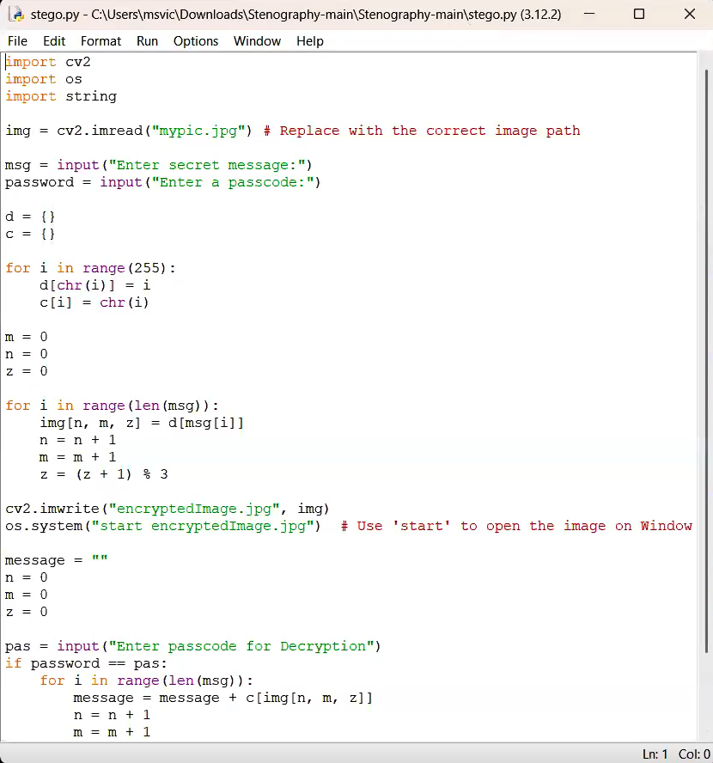
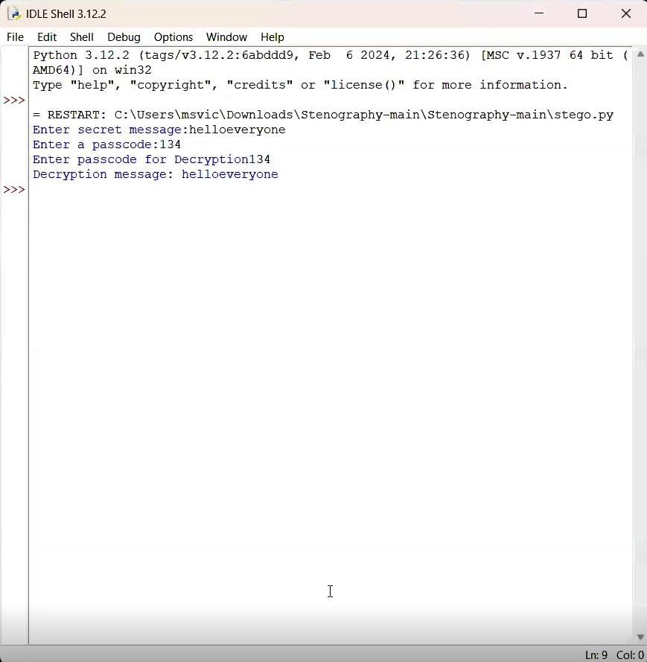
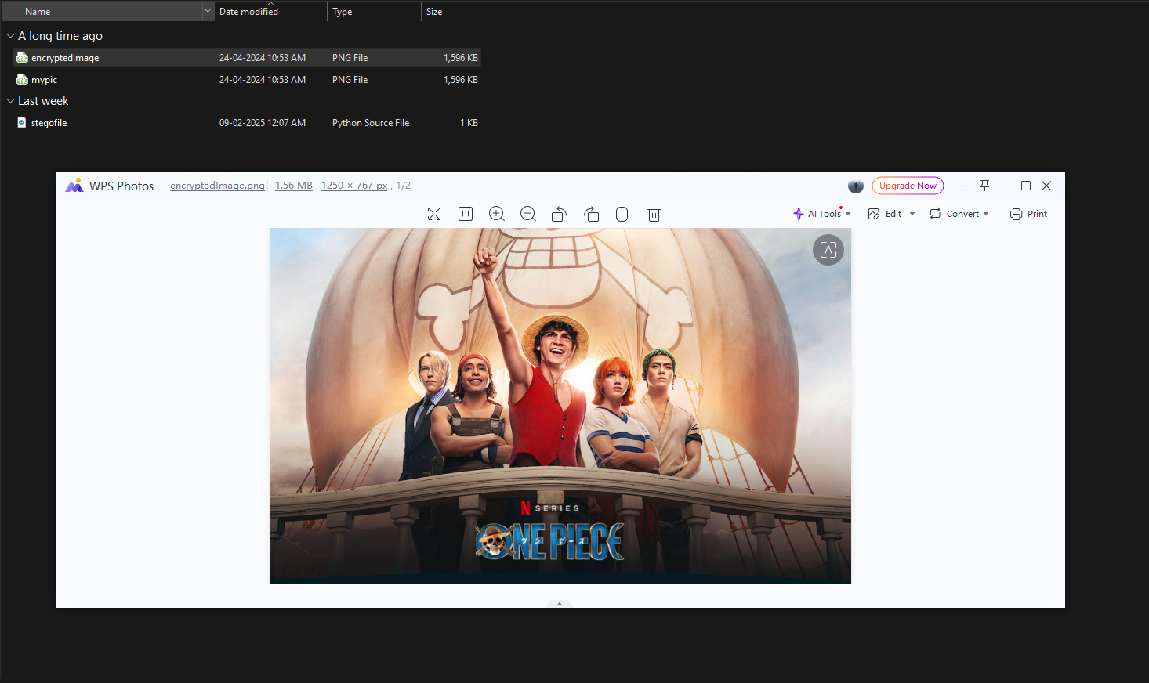
Results

Slide 8
Conclusion
The project "Secure Data Hiding in Images Using Steganography" provides a robust and efficient method for concealing sensitive information within digital images. By leveraging image processing techniques, encryption, and a user-friendly interface, the system ensures high security while maintaining image integrity. The implementation of OpenCV and Tkinter makes it accessible and efficient, with minimal impact on file size and quality.
This solution is valuable for cybersecurity, government agencies, financial institutions, and researchers, offering a secure means of confidential data exchange. With its cross-platform compatibility, multiple image format support, and customizable encryption, the project stands out as a practical and innovative approach to secure communication.

Slide 9
GitHub Link
Github link:- https://github.com/rudrarajsinh-gohil/Steganography.git

Slide 10
Future scope(optional)
Advanced Encryption Integration – Implementing stronger encryption algorithms alongside steganography for enhanced security.
AI-Based Detection Prevention – Using machine learning to optimize embedding techniques, making hidden data even harder to detect.
Cloud Storage & Transmission – Enabling secure storage and transmission of steganographic images over cloud platforms.
Mobile Application Development – Expanding the project to Android and iOS for on-the-go secure data hiding.
Support for Video & Audio Files – Extending steganography techniques beyond images to include videos and audio files.
Real-Time Steganography – Developing real-time encoding and decoding for instant secure communication.
Blockchain Integration – Leveraging blockchain technology to track and verify the authenticity of steganographic files.
Steganalysis Resistance – Enhancing methods to resist detection from steganalysis tools and attacks.

Slide 11
THANK YOU

